Slide 1
Course : Computational Physics
Effective Period : April 2022
Simulating Basic RC Rectifier Circuits

Slide 2
Objective and Outline
LO : Implement a computational simulation of basic electrical circuits using Python programming language
In this course we will be simulating power electronic circuits using Python. However, the Python part is not heavy. This course is ideal for students only with a basic knowledge of network theory and programming to get started with simulating simple power electronic circuits. The course contains a basic introduction to the Python Power Electronic (PPE) and describes how to use it to simulate simple rectifier (RLC) circuits.
In this session, we will start exploring a simulation concept using Open-Source Python Power Electronics
Download : https://www.pythonpowerelectronics.com/
Outline
Adding a Capacitor to a basic Rectifier circuit
Analysis of basic Rectifier and energy storage
Analysis of the rectification output graph

Slide 3
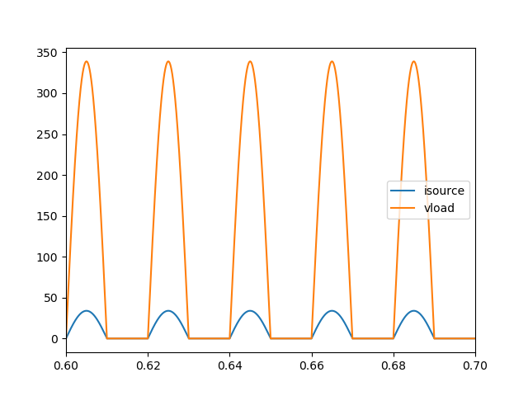


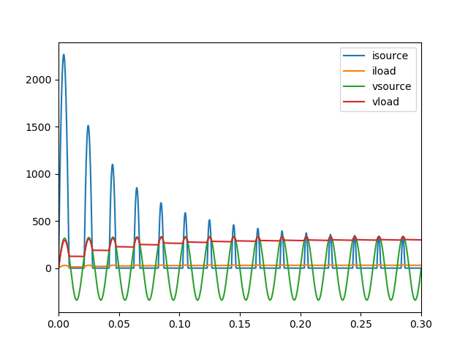
Capacitor
Capacitors draw larger currents when the voltage across them rapidly changes and are used when the intention is to remove currents that can be rapidly fluctuating and could otherwise disrupt the circuit.
The nature of a capacitor is the integral of the current in a circuit.
Do you remember what an integral means?
A capacitor will not allow the voltage across them to fluctuate rapidly. And this is even though it draws rapidly fluctuating currents towards itself. This makes them ideal candidates where a stable voltage is required where otherwise the voltage could flicker too much

Slide 4
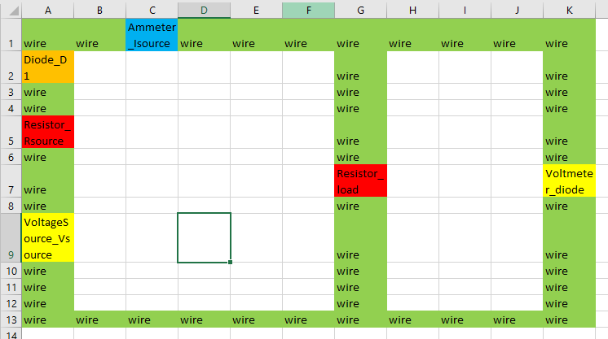
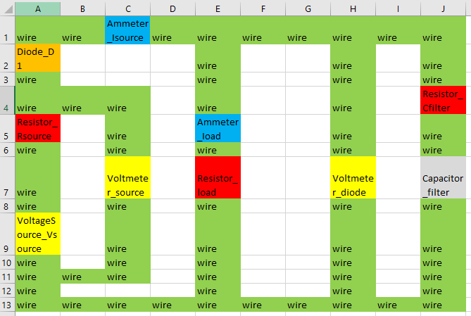
Simulating Basic RC Rectifier Circuits
Open MS Excel and recreate the circuit design
Rules: ComponentType_ComponentName and its case sensitive.
Save in basic .CSV file → e.g D:\...\simulations\capacitor_example\capacitive_rectifier.csv (this is your WORKING DIRECTORY)
In the last session we have this circuit, now we will add a capacitor to the output.
Remember, a capacitor always connected on between a node as a parallel branch where you want to regulate the load.
Capacitor can’t be used standalone with no resistance, then we need to put very small parasitic resistor

Slide 5
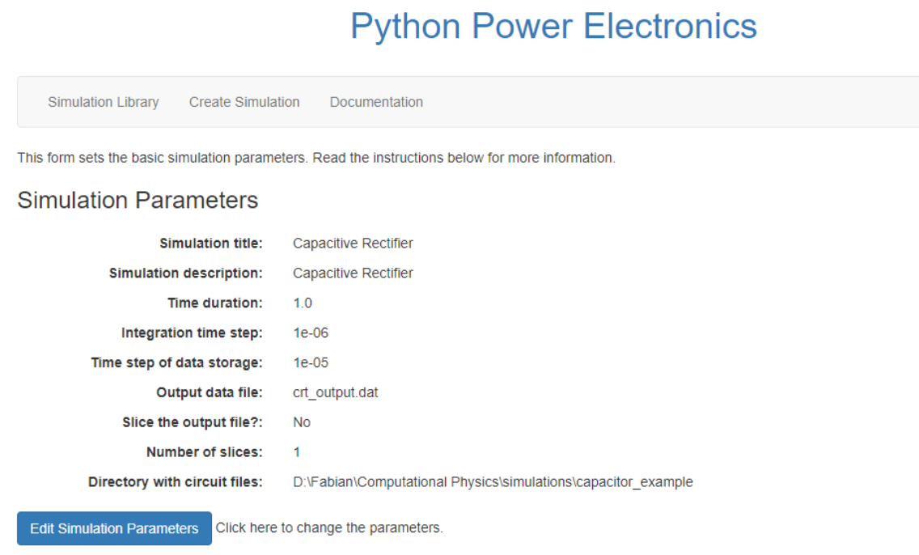
Webserver launch reminder!
Activate ppe environment
Go to manage.py folder directory (launch file)
If the structured database is already created, run the webserver by python manage.py runserver
Copy http://127.0.0.1:8000/ (or other URL) and run in your browser
Creating simulation
Run the PPE webserver
Create new simulation ‘Capacitive Rectifier’, add your working directory file.
Solve the warning if there is any, save first, and you can edit later when you need it.
The smaller the integration time, the higher the sampling frequency. But longer processing time. The larger the faster, but you lose some data record

Slide 6

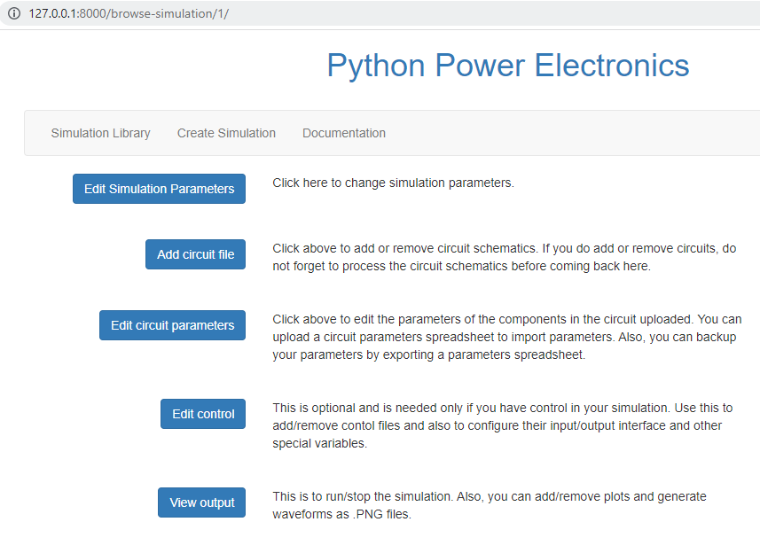
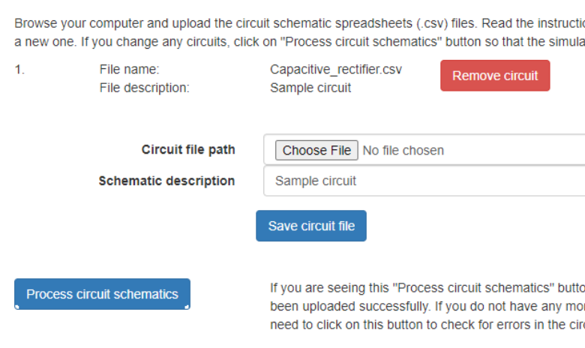
Adding minimalistic circuit simulation
Check is the testfile is created in the WORKING FOLDER
Open and understand the .CSV file structure using word editor
Go to Simulation Library → Load the Rectifier Simulation → Back to Main Page
Add circuit file → select file → safe circuit file → process circuit schematic
If error, update the .CSV file → process circuit schematic. No need to reupload
Then → Back to main page

Slide 7
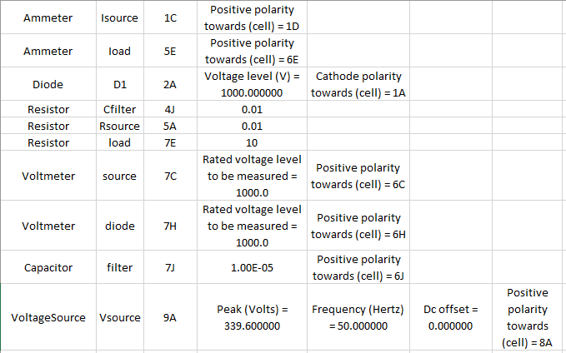
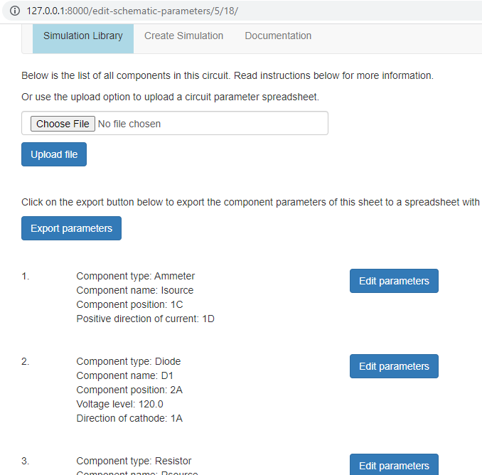
Simulating Basic RC Rectifier Circuits
Edit Circuit Parameter
Click Edit circuit parameter → Edit parameter and change according to the parameter here.
We tried to simulate the numbers and component behaviour

Slide 8
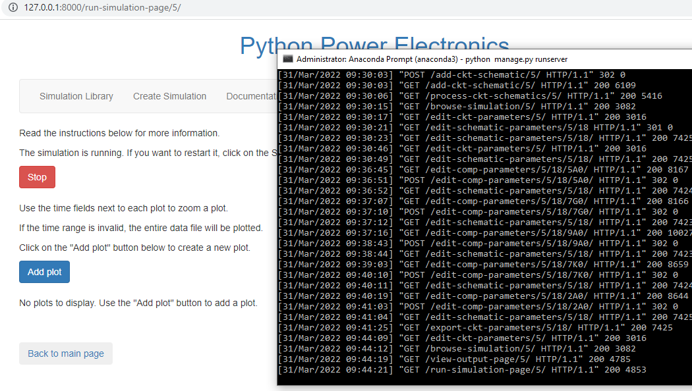
Simulating Basic RC Rectifier Circuits
Run Simulation
Go back to the main menu → Click View output
Check if there is any error on the anaconda prompt
Run the simulation → add Plot

Slide 9
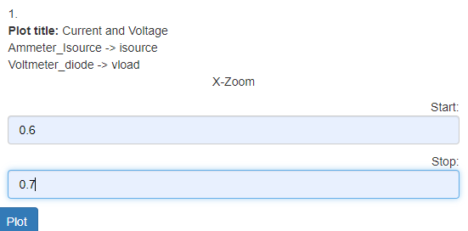
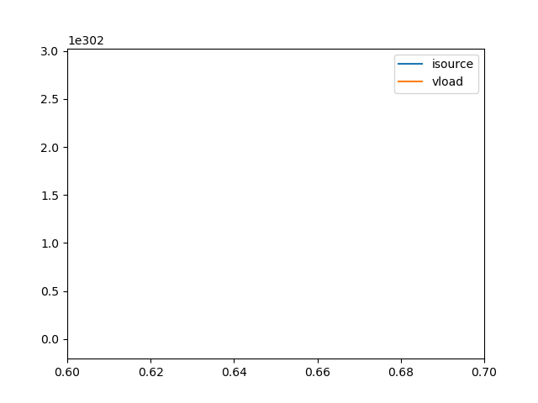
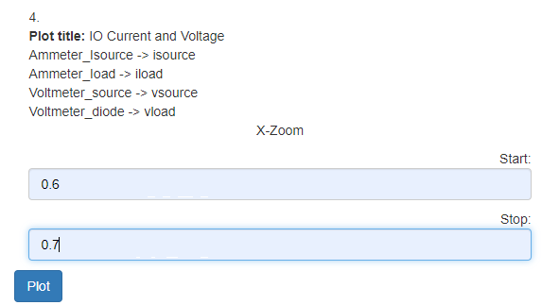
Simulating Basic RC Rectifier Circuits
Plot Simulation
Add Plot → follow the setup → Plot and see the Graph
Simulation instability!
Typically, because of the time constrain on the simulation
The integration time step is not small enough

Slide 10
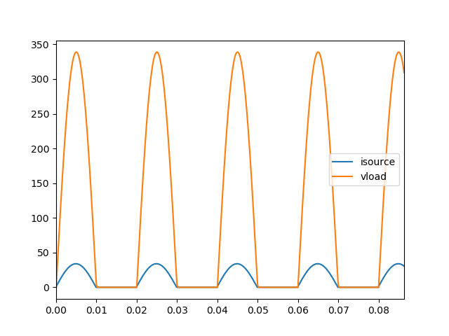
The time constrain of the RC circuit is R.C.
We have 2 Parasitic resistor + 1 Diode = 0.03 Ohm resistance → almost negligible
0.03 Ohm * 10.00 µF =3e-07 (Our minimum time constraint)
While our simulation integration time step is 1e-06.
Meaning that out simulation is changing faster that we solving it. We have two solution !
Increase the integration time step, or
Increase 1 of the parasitic resistance to 0.1 → we choose this!
To fix the simulation
Stop the simulation
Edit circuit parameter
View components
Increase the Cfilter resistor, or any other resistor to 0.1 Ohm
Plot the V and I again to see the effect
It shows the same graph as the previous one!
Typically, because our Capacitor is not big enough to make a steady DC output. Let’s make it larger!

Slide 11
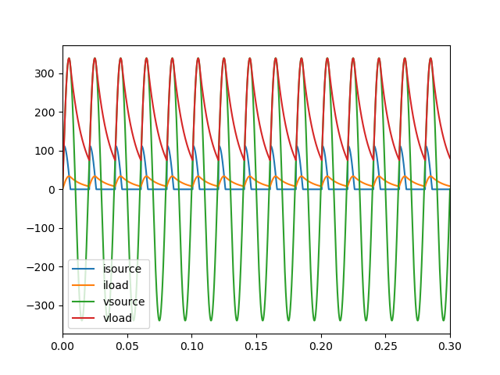
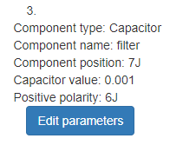
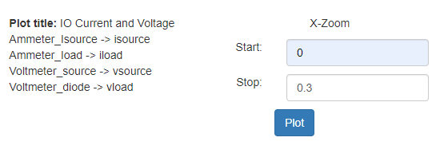
Because our Capacitor is not big enough.
Change your Capacitor to 1000 µF and see the result
Stop simulation, Edit circuit parameter, save, Run the simulation and Plot again the same graph
We could see that the current and voltage are much steadier. How about if we put more energy storage on the capacitor?
Do the same steps as above, and make the capacitance bigger
Capacitor value = 100000.0e-6
Plot larger X-axis (put 0 on start and 0.3 on stop) ☺

Slide 12
What we have learned so far
Adding the capacitor creates an instability and time constraint because the circuit is changing to rapidly. The solution is to increase the parasitic resistor/ Integration time step
The energy storage has a very high effects. It it’s too small it has no effects on creating steady net positive current and voltage
On the newest graph, focused on the change between the input and output. For Current: Blue → orange (much flatter curve). For Voltage: Green → Red (from zero net cycle to positive net and flat curve)

Slide 13
Creating DC Load on a computer that requires a steady Voltage and Current! Its not enough
Discussion
Congratulations! We are able to create a stable DC output with net positive voltage and current using a diode and capacitor.
This is achieved by using higher value of Capacitor. However, this settings might still break our device, as there is no limit to the current and buffering the energy output.
We will add another component on the next class. Can you guess what is it and what is the function of that component?

